Slide 1

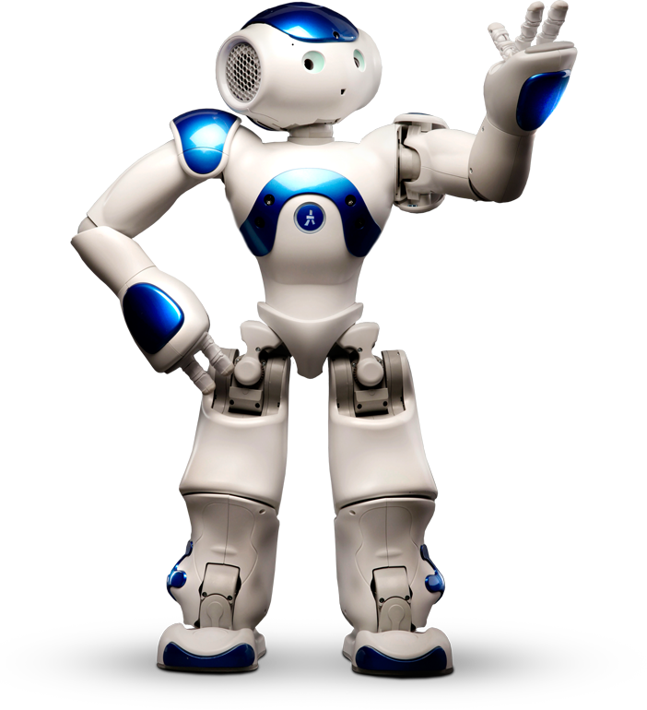
Robotics
Human-Robot Interaction
Team: Casey Chen, Hailey Dhanens, Matthew Harker,
Angie Quach, & Derek Vaughan
Client: Dr. Szilárd Vajda
Supervisor: Dr. Donald Davendra
January 31, 2019

Slide 2
Table of Contents
1
Recap from Last Quarter
Requirements and NAO’s Past, Present, & Future Capabilities
Coding with NAO (Choregraphe, etc.)
Problems/Issues Thus Far
Remaining Project Schedule (Gantt Chart)
Conclusions
Tech Demo

Slide 3

Recap:
2
What is NAO?
Problem Statement: Showcase meaningful human-robot interaction using the Aldebaran NAO robots acquired by CWU.
Our Roles: Slight changes to original team structure such that everyone can more effectively contribute.

Slide 4

3
Past, NAO, & The Future!
Notes:
Hi I’m Angie and I’ll be talking about the past, present, and future of NAO’s capabilities.

Slide 5
Requirements & NAO’s Initial Capabilities
4
Our Requirements:
Respond verbally and physically
to various commands
Image-based detection
Small games using
advanced movements
Initial Capabilities:
Simple responses (e.g. “Hello”)
Basic information about
its onboard systems
Few movement options
Various language options
Notes:
Right off the bat…
THE PAST.
Our project requirements are: have NAO respond verbally and physically to various commands, use NAO’s image-based detection, and make small games using custom advanced movements. Although NAO pretty much did all of these things, we wanted to improve its interaction with humans because let’s face it -- robots are creepy.
In the beginning, our NAO robot was capable of giving information about its onboard systems like: What’s your battery level? & What’s your IP address? It was also able to say hi back when you greeted it. As for movement options, NAO could stretch its head, arms, and legs or go to the extent of doing tai chi. Also, NAO’s language options can be set to English, Japanese, or French.

Slide 6
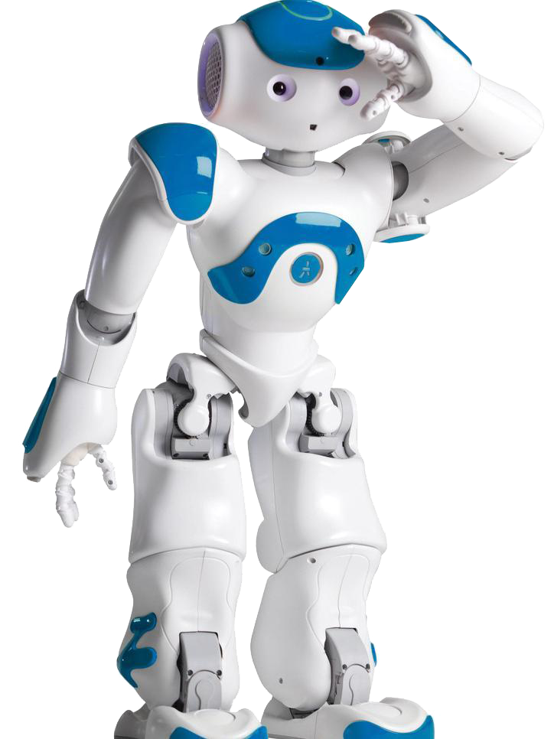
What is NAO Currently Capable Of?
5
Expanded pool of verbal responses
Advanced movement options
Facial recognition of AriGato team members
Small “easter eggs” (e.g. Jazz Hands)
Notes:
As of present day, NAO is currently capable of an expanded pool of verbal responses. It can answer questions like How old are you? & How are you doing? where there are multiple answers and one is randomly chosen, and it can also answer What is the current temperature? The program uses WiFi to access a weather app that returns Ellensburg weather.
We also programmed modules that allow advanced movement options, so NAO can lift its left and right arm or raise its left and right foot. The facial recognition module is another one our team made and tested with our own faces. The robot has learned our faces and when we prompt it, NAO will greet us and say our name. We have also created small easter eggs like jazz hands or sing the national anthem.

Slide 7
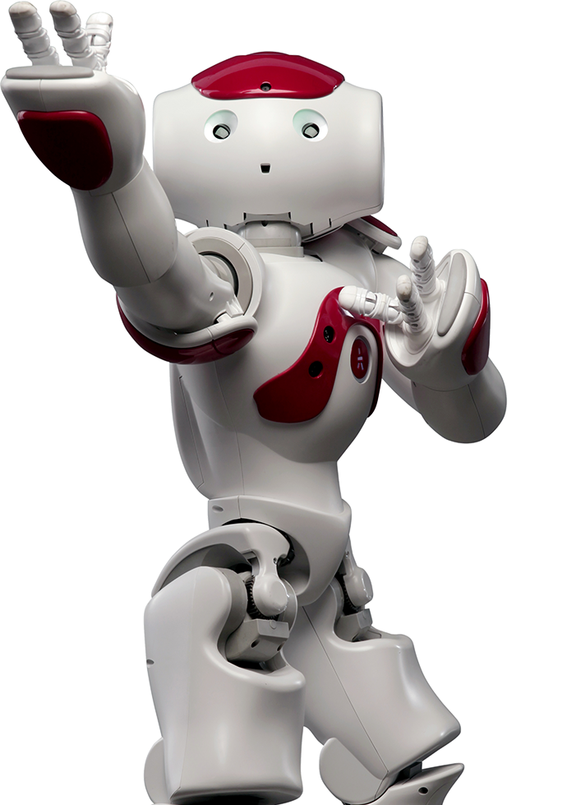
What’s Next for NAO?
6
Furthering its movements & verbal responses (parsing parameters)
Playing small games and dances
Advancing facial recognition features
Emotions (recognition & response)
Notes:
Moving forward, one of the robots next steps is creating more fluid movement options and verbal commands. We’re exploring parameter parsing right now so that way the robot can parse human input into arguments, for example: if someone asks NAO to take 5 steps, 5 would be the number input.
More goals that we have include developing a small game for NAO like picking up a red ball; advancing the facial recognition module features so NAO can remember information about a user, store it, and use it for the next time a conversation takes place with the same user; and creating a module for emotion recognition with a caring response.
Now I’ll hand it off to Matt who will talk about Coding with NAO.

Slide 8

7
Coding with
NAO
Notes:
Matt Harker

Slide 9
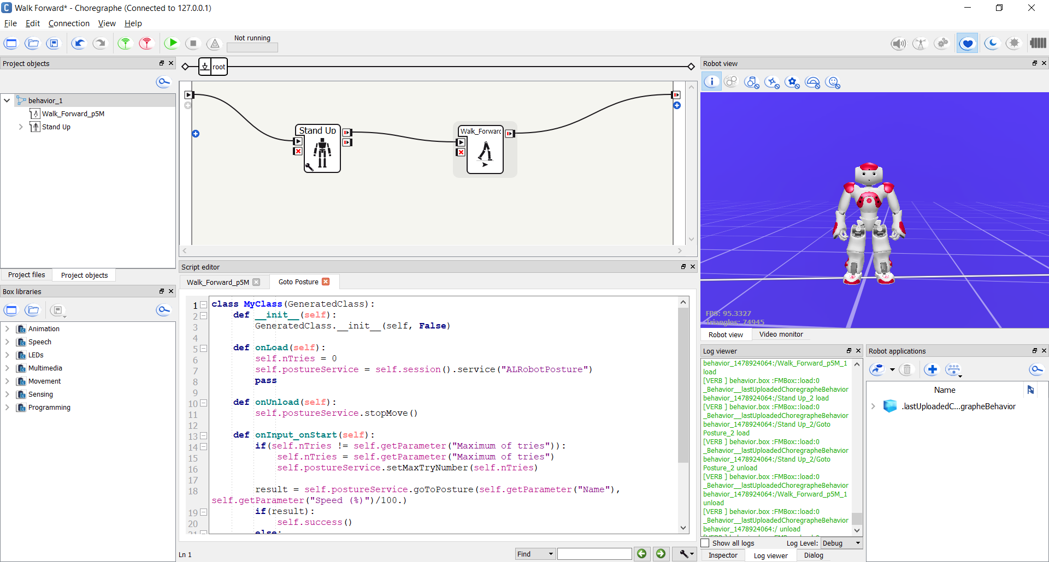
The Choregraphe Environment
8
Notes:
Matt Harker
This is the Choregraphe environment. This is what allows us to actually work on the robot.
This environment give us plenty of tools for us to efficiently produce code, as well as providing as much information as we need about the robot’s current state.
In the top right is a 3D representation of the robot. This display will either match what a connected physical robot’s current state is in real time, or it will display a virtual representation of what a robot would be doing.
Below this window are two other windows which are showing More information about the current state of the machine.
To the left and up of these is the workbench, where different “boxes” are connected together, and I will talk more in depth about these boxes soon.
Below these boxes is the built in IDE, which is where most of our work is currently being done.

Slide 10
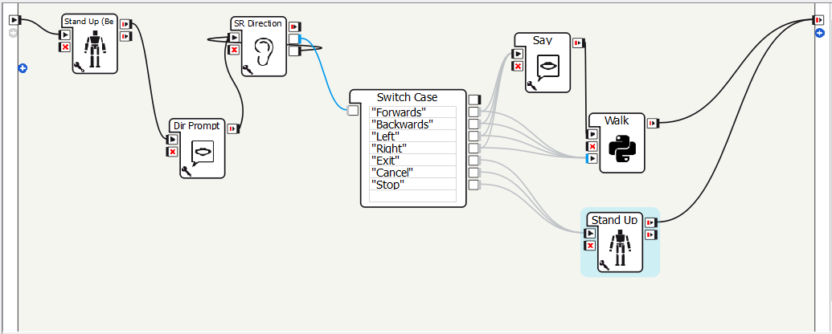
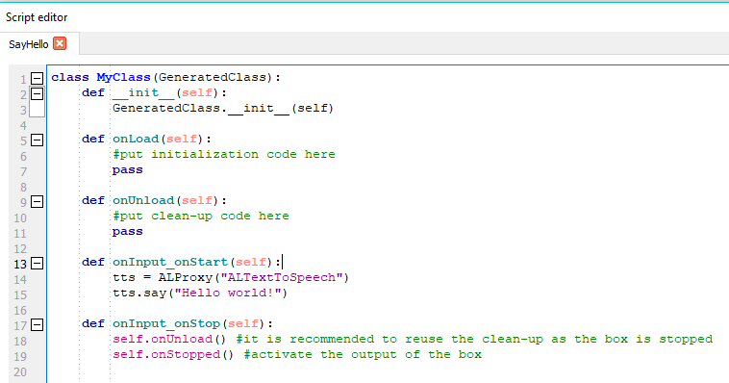
Steps for Creating a Module:
9
Many boxes with simple functions are provided
Create a new Python box in the workbench
Creates a template for us to modify
Press “Play”
Notes:
Matt Harker
Choregraphe already provides us with many boxes which we can implement into our modules. However, these tend to be fairly restrictive in how we can modify them.
Because of this, most of our work ends up in Python Boxes. Once we add a python box to the work bench, it automatically provides us with a skeleton of a program, by providing us with multiple empty functions. Currently we are really only using one function, the “On Start” function, as this is the one that runs when the box is activated in the workbench.
Once we have finished writing our code in the boxes, and linking the boxes together, we run the program selecting the play button at the top on the screen

Slide 11
Example Hello World Function
10
Notes:
Matt Harker
This is an example of a Hello World program done in one of the Python boxes, with the most relevant part highlighted. This program will have the robot say the phrase “Hello world”
Text to speech proxy that we are using in the module

Slide 12
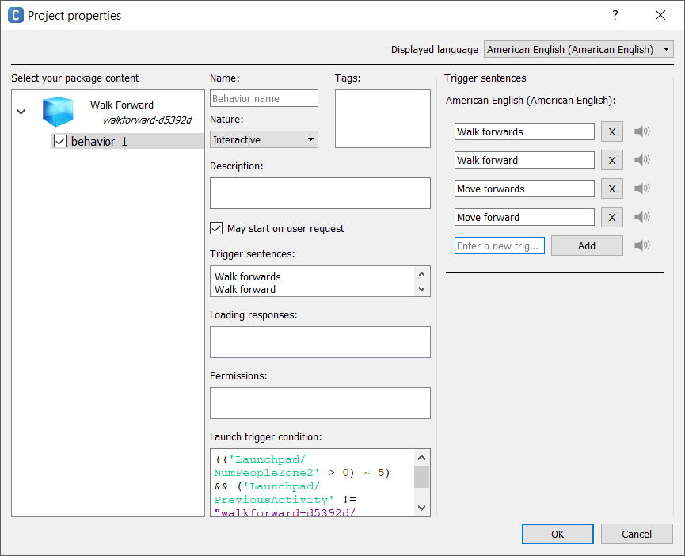
Steps for Creating a NAO module (cont.):
11
Ability to set up trigger and response phrases.
Install modules by selecting “Install to robot” while connected to the computer.
Allows programs to run independent of Choregraphe
Notes:
Matt Harker
As far as getting these modules onto the robot, the process is fairly easy
First we go into the program’s properties and give it a list of Trigger Sentences. These are the phrases which will activate the program
We also modify the launch conditions to ensure the robot doesn’t accidentally activate when it is not supposed to
Finally, once this is set up, we are able to install the module to the robot with a single button press from the main choregraphe screen

Slide 13

12
Problems
Encountered

Slide 14
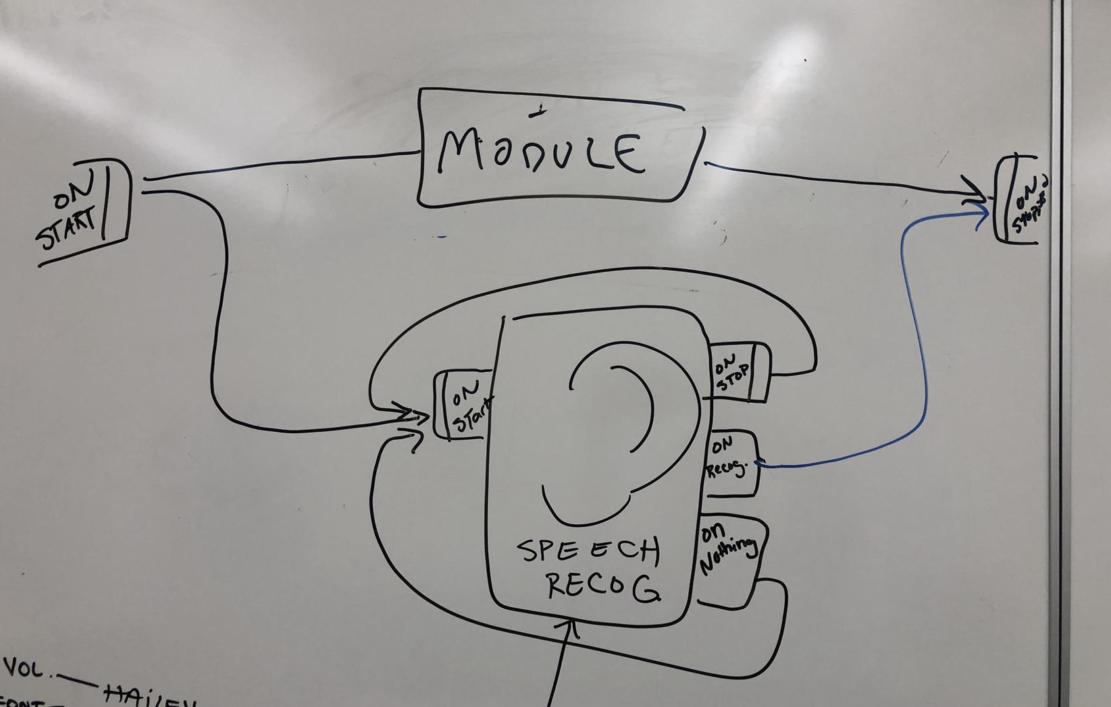
Problems & Solutions
13
Choregraphe issues
Infinite loops
Recognizing parameters from voice commands
Stop module to halt behaviors while in progress
Notes:
Infinite loops:
-angie’s 30 minute national anthem module
-derek’s left foot module
-angie’s face recognition module

Slide 15

14
Remaining
Project Schedule

Slide 16
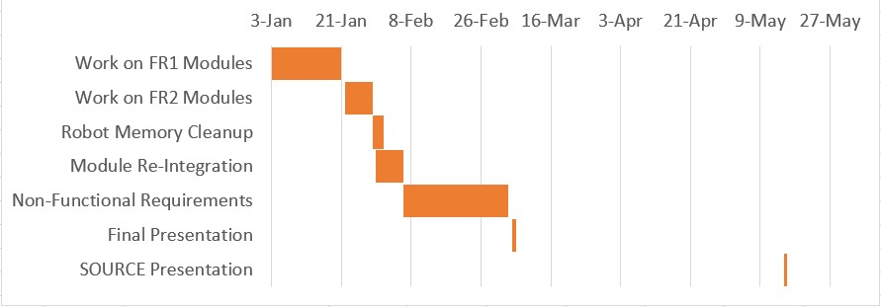
Plans Through the Rest of the Quarter...
15

Slide 17
Conclusion
16
Completed
Basic limb movement options
Small pool of voice commands
Easter eggs (National Anthem, jazz hands, etc.)
To-Do
Human waving detection
Detecting emotion in human voice
Small games with NAO’s sensors
Advanced Internet integration
Other advanced applications

Slide 18
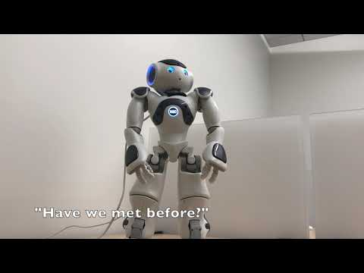
17
Tech Demo

Slide 19
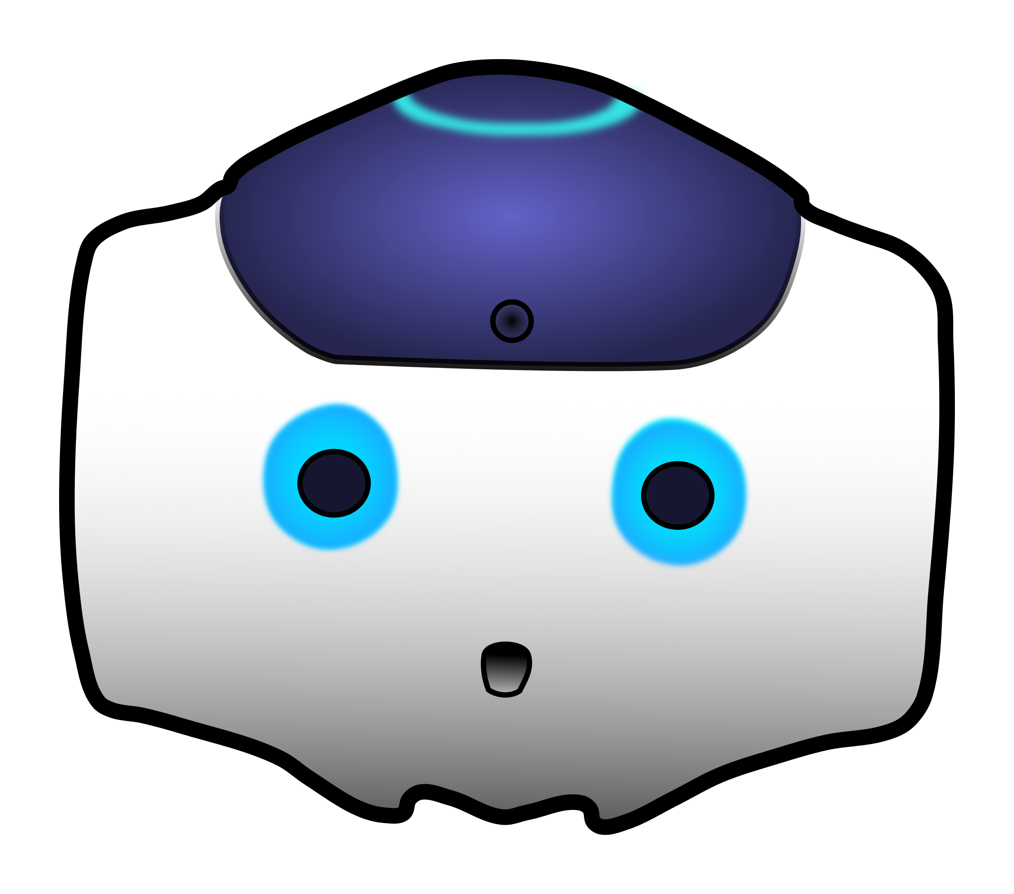
18
Thank You!
Questions?

